Slide 1
How to Draw a Normal Probability Plot
Arrange your x-values in ascending order.
Calculate f_{i} = (i-0.375)/(n+0.25), where i is the position of the data value in the ordered list and n is the number of observations.
Find the z-score for each f_{i}
Plot your z-score on the horizontal axis and the corresponding x-values on the vertical axis.
Ex) We have 7 values : 29, 32, 33, 45, 46, 54, 55
1 2 3 4 5
0.1 0.3 0.5 0.7 0.9
 | 29 | 32 | 33 | 45 | 46 | 54 | 55
f | 0.0862 | 0.224 | 0.362 | 0.5 | 0.638 | 0.776 | 0.914
P(Z<z)=f | -1.364 | -0.758 | -0.353 | 0 | 0.353 | 0.758 | 1.364

Slide 2
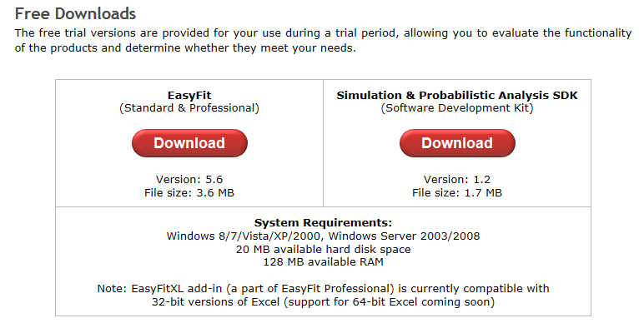
EasyFit
http://www.download3000.com/download-easyfit-count-reg-9662.html
Download
http://www.mathwave.com/downloads.html

Slide 3
Airport Simulation
Is it necessary to build new runway to serve the increasing traveling customers after 10 years?
We can analyze by computer simulation.
In order to reproduce the operation of the runway inside the computer, we need to know the inter-arrival time distribution of the airplanes, the landing time distributions of the airplanes.
We measure the landing times of the airplane and want to know the distribution type that fits well to the measured data to generate the random values that depict the landing times in the simulation.
So we need to find the appropriate probability distribution for the given data.

Slide 4
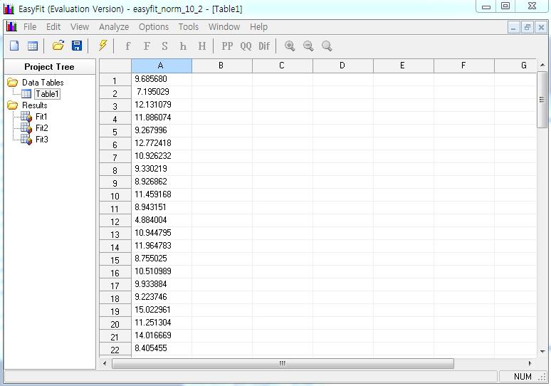

Slide 5
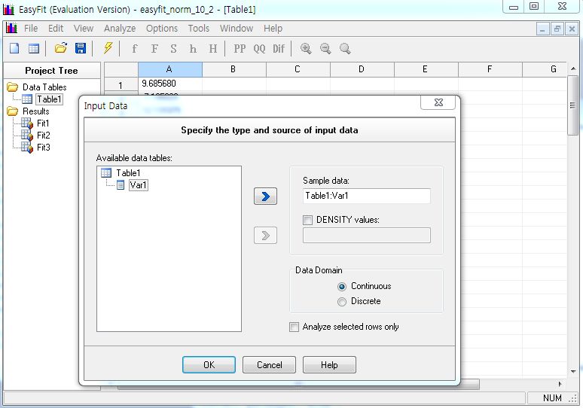

Slide 6
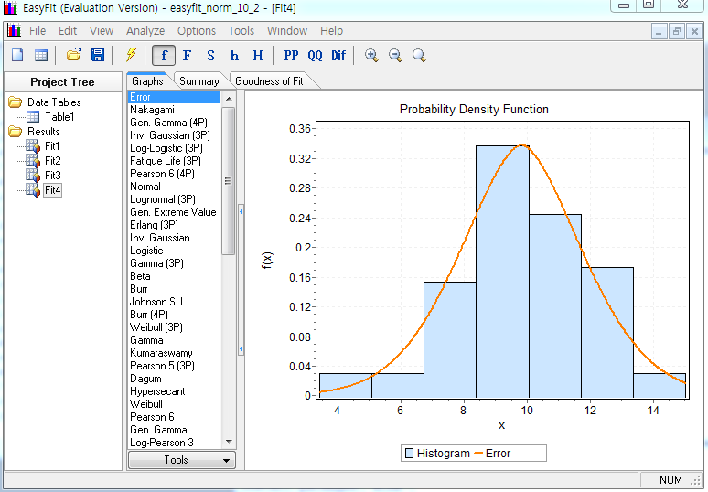

Slide 7
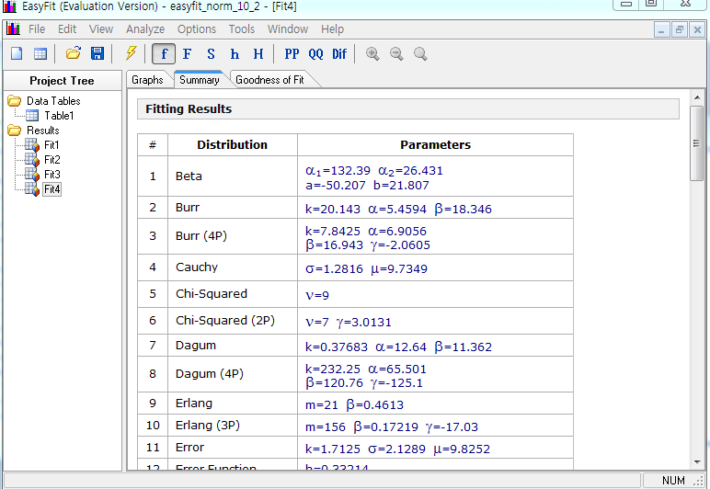

Slide 8
